Slide 1
Digital Portfolio
STUDENT NAME: SUJITH BALAJI K
REGISTER NO AND NMID: 24BCS133&asbru001224BCS133
DEPARTMENT: COMPUTER SCIENCE
COLLEGE: COLLEGE

Slide 2
PROJECT TITLE
PERSONAL DIGITAL PORTFOLIO

Slide 3


AGENDA
Problem Statement
Project Overview
End Users
Tools and Technologies
Portfolio design and Layout
Features and Functionality
Results and Screenshots
Conclusion
Github Link
3/21/2024 Annual Review

Slide 4

PROBLEM STATEMENT
Students often lack a professional and organized way to showcase their skills, achievements, and projects online. A digital portfolio helps present these in a structured and attractive manner.

Slide 5

PROJECT OVERVIEW
This project is a simple digital portfolio website designed to highlight academic background, skills, projects, and contact details. It serves as an online resume and career identity

Slide 6

WHO ARE THE END USERS?
Students (to showcase skills & projects)
Recruiters (to evaluate candidates)
Teachers & mentors (for academic reference)

Slide 7

TOOLS AND TECHNIQUES
HTML5 – Structure
CSS3 – Styling
JavaScript – Interactivity
GitHub – Hosting & version contro

Slide 8
POTFOLIO DESIGN AND LAYOUT
Homepage with introduction
About Me section
Skills & Projects showcase
Contact details
Simple, clean, mobile-friendly design
8

Slide 9
FEATURES AND FUNCTIONALITY
Responsive design (works on mobile & desktop)
Easy navigation menu
Showcase of academic & personal projects
Contact form / links to email & LinkedIn

Slide 10
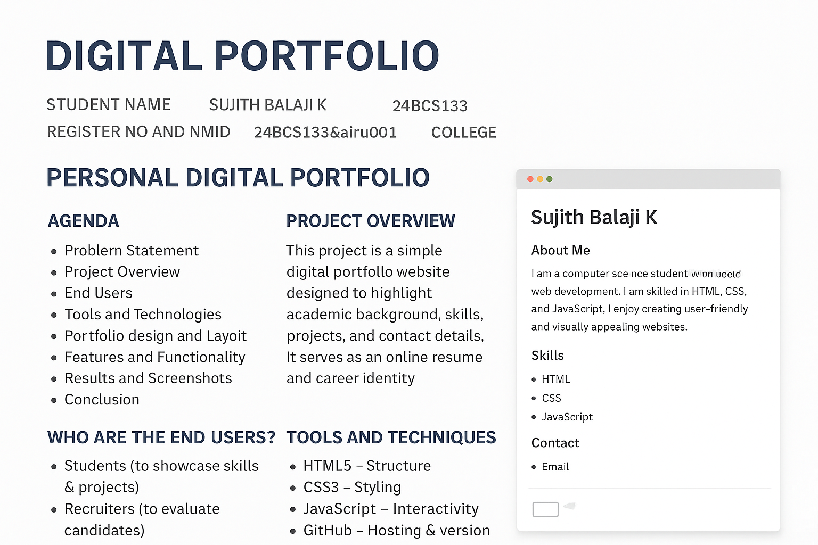

RESULTS AND SCREENSHOTS
3/21/2024 Annual Review
10

Slide 11
CONCLUSION
The digital portfolio provides a professional way to present achievements and projects online, making it easier for recruiters and institutions to evaluate candidates.
11

